Slide 3
What is B-Tox Peel?
B-Tox Peel, can be named as Algae Peel or Invisible Needle Peel.
By using Biological Technology, scientists use the natural ingredient and extract into Silitox Needles (Needle Sponge Extract).- A very tiny micro needles size within 50-200um.
After massage B-tox peel on the face, Silitox needles will penetrate into the skin layer to stimulate and regenerate the skin.

Slide 4
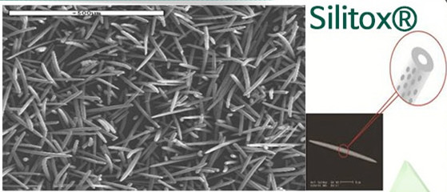
What is SiliTox™
Silitox TM is patented ingredient that made of the extract from Benthos (Type of Coral).
By using nano-technology, scientists form the extracts into micro needles. These Silitox TM needles are 100% natural and contains very rich minerals. Unlike other peel products, it does not contain acid or medicinal herbs

Slide 5
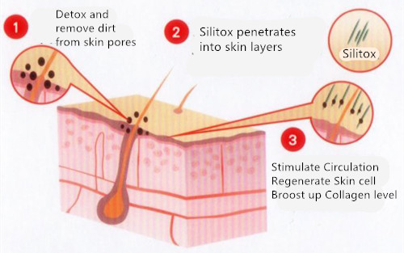
How Does B-Tox Peel Works?
The procedure is that you rub mixture of this powder and ampoule on the skin and penetrate them on the skin.
(To avoid prickliness, you can apply Anesta (anesthetic cream) when you rub it on your customers skin)
These mineral rich Silitox penetrates into the dermis and the epidermal layer of the skin and for 48 hours continuously stimulates blood circulation. By promoting the epidermal cell, it not only allows thickened scaly skin layer, but helps eliminate dead skin and keratin that were built up in the pores and epidermis. It also helps accelerate cell regenerative cycles

Slide 6
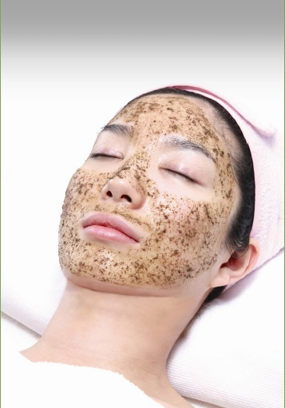
Advantage of B-Tox
100% Natural Ingredients with rich mineral
Smallest damage on epidermis layer of skin. Silitox will be absorbed by the skin.
No Chemical, No Acid, No Medical Herb Allergy
After treatment, does not affect to daily life.

Slide 7
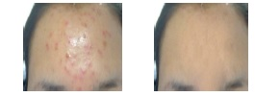
What type of skin can be used with B-Tox?
B-Tox has very excellent results on Oily Acne Skin, Pigmentation, Uneven Skin Tone and Aging Skin.
Silitox removes and detox the epidermal layer of skin. Soothes inflammation and minimize the skin pore. Reduce the bacteria for acne infection.
Recommendation:
B-tox Peels once every 2 weeks for 2 months (4 times).
One Detox Purifying skin treatment in between each B-tox Peel treatment.
Acne Skin

Slide 8
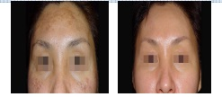
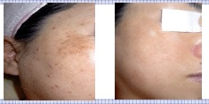
Silitox stimulates the circulation and cell regeneration. It boost up the skin collagen level and elastin of the skin. Smooth the wrinkles and soften the skin.
Recommendation:
B-Tox Peel once every 2 weeks for 2 months
(4 times)
Skin Rejuvenation treatment in between each B-Tox Peel treatment
Aging Skin
Pigmentation
Silitox removes dead skin and leaves the skin radiant one and healthy skin. Prevents blemish, age spots and removes keratosis.
Recommendation:
B-tox Peel once every 2 weeks for 3 months
(6 times)
Pigmentation treatment in between each B-tox peel treatment.

Slide 9
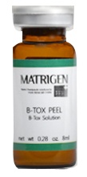
B-Tox Treatment Set
Each Set has 2 Treatments.
B-Tox Powder
(Sili-tox micro peeling powder)
100% natural peeling powder based on the deep-sea bio silica penetrates
deep skin to help the absorption of other products and regeneration
and escape of dead skin cell on the basis of skin circulation mechanism.
1g / 2 Bottle in 1 Set
*Use during the treatment
B-Tox Solution
(Solution to be mixed
with peeling powder)
Sili-tox penetrates deep skin to maximize
the effect, and it is necessary
to mix with the Sili-tox powder
to mitigate the skin stimulation
And helps to be established
inside skin
8ml / 2 Bottle in 1 Set
* Use during the treatment
B-Tox Calming Ample
(Peeling calming & moisturization ample)
It applied for the calming after
peeling. Sili-Tox penetrates
to calm down redden face
while fully preventing
the dryness with the
top-class moisture
inducer, urea.
10ml / 2 Bottle in 1 Set
*Use After the treatment (1st day)
B-Tox Regenerating Ample
(Skin cell recovery & circulation healing ample)
According to the rapid skin circulation
cycle due to Sili-Tox, this ample
encourages the skin cell vitalization
while providing dynamic healing
with the placenta, aloe,
and collagen
10ml / 6 Bottle in 1 Set
* Use After the Treatment (2 weeks)
**After 1st Treatment, the 2nd treatment can be done after 2 weeks.

Slide 10
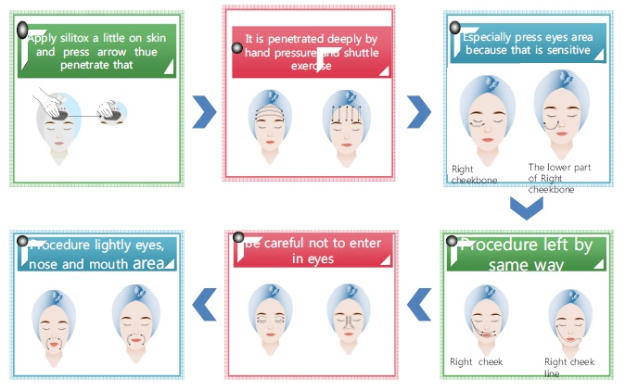
How to use: After Cleansing the skin
Step 1 - Mix powder and solution by 1:1 ratio. Apply solution on facial skin and massage/rubbing for 10-15 mins.

Slide 11
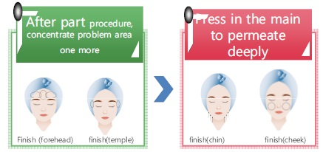
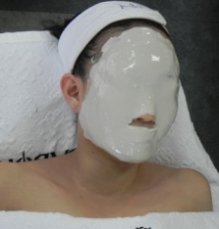
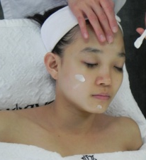
Step 2 – Use Wet Cotton to put on the face (with B-tox peel) for 5 minutes. Let the B-Tox peel penetrate into the skin.
Step 3 - Clean the face with wet cotton for excess B-Tox Peel. Apply Calming ampoule to treated areas to make it soothe. Then, put the mask
Step 4 - Apply Regenerating ampoule and moisturizing skin careto finish off.
**Must apply UV Sun protection cream after B-Tox Treatment.

Slide 12
Daily Reaction After Treatment
One – Three Days | Tingle and Red Must apply Skin Calming Skin Care
Three – Five Days | Removing Dead Skin Cell. Pigment might appear more darken. But will become lighten and brighten Must apply UV Sun Protection Cream
Six – Ten Days | Dry but skin will feel more tighten and lifting Keep Hydrating the skin.
Ten – Fourteen Days | Skin become more soften and brighten.

